Slide 1


According to the CDC, the US Adult obesity prevalence was 41.9% in 2017 – March 2020.(1)
“Obesity is not a personal failure, it is a societal failure.”_George A. Bray(3)
Group Members
Emilia Roberts
Elona Xhikola
Raghen Morrow
US ADULT OBESITY FACTORS
The Role of Walkability, Income, & Weather on US Adult Obesity

Slide 2
Project Overview

Slide 3

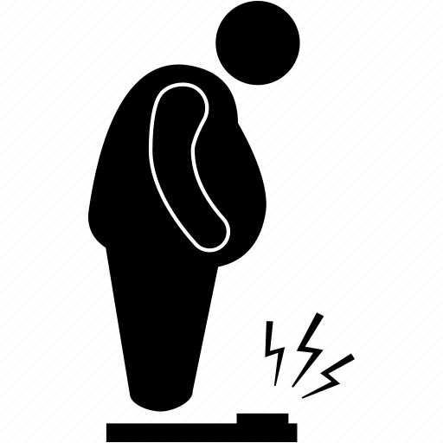
Possible Obesity Causes
Genetics
Environment
Cardio Vascular Disease
Cancer
Effects
Physical Inactivity
Socio Economic Status
Psychosocial Problems
Insulin Resistance/Diabetes
Eating Behavior
Causes
Sleep Apnea
Arthritis

Slide 4


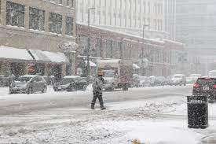
Evaluated Obesity Causes
How important are these factors when it comes to population healthcare dynamics, in this case obesity?
Physical Inactivity/ Environment: Walkability
Socio Economic Status: Income
Environment: Weather

Slide 5
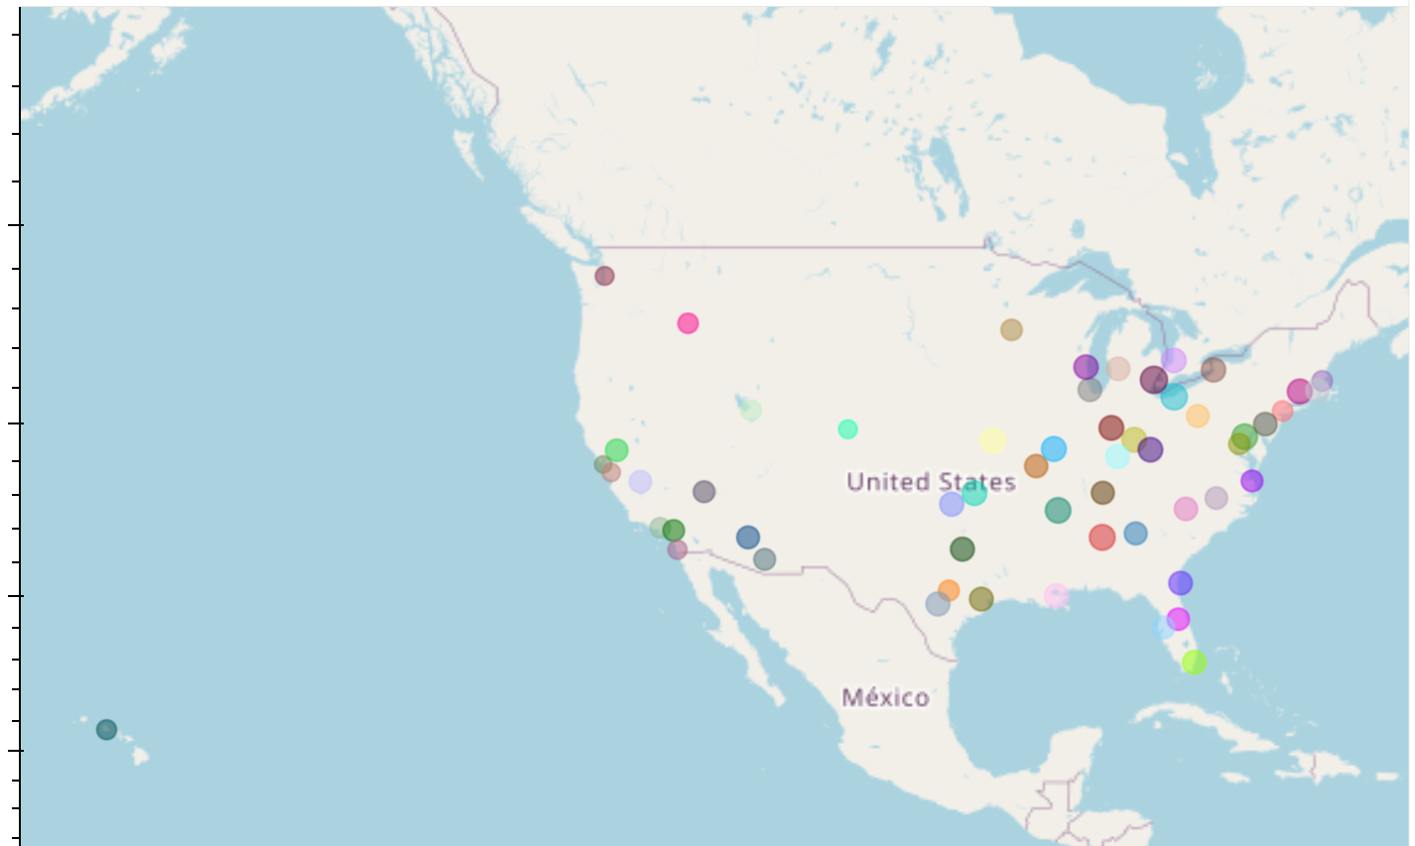
Data Analysis Focus
56 Major US Cities
Atlanta, Georgia
Austin, Texas
Baltimore, Maryland
Birmingham, Alabama
Boston, Massachusetts
Buffalo, New York
Charlotte, North Carolina
Chicago, Illinois
Cincinnati, Ohio
Cleveland, Ohio
Columbus, Ohio
Dallas, Texas
Denver, Colorado
Detroit, Michigan
Fresno, California
Grand Rapids, Michigan
Hartford, Connecticut
Honolulu, Hawaii
Houston, Texas
Indianapolis, Indiana
Jacksonville, Florida
Kansas City, Missouri
Las Vegas, Nevada
Los Angeles, California
Louisville, Kentucky
Memphis, Tennessee
Miami, Florida
Milwaukee, Wisconsin
Minneapolis, Minnesota
Nashville, Tennessee
New Orleans, Louisiana
New York, New York
Oklahoma City, Oklahoma
Orlando, Florida
Philadelphia, Pennsylvania
Phoenix, Arizona
Pittsburgh, Pennsylvania
Portland, Oregon
Providence, Rhode Island
Raleigh, North Carolina
Richmond, Virginia
Riverside, California
Rochester, New York
Sacramento, California
Salt Lake City, Utah
San Antonio, Texas
San Diego, California
San Francisco, California
San Jose, California
Seattle, Washington
St. Louis, Missouri
Tampa, Florida
Tucson, Arizona
Tulsa, Oklahoma
Virginia Beach, Virginia
Washington, DC

Slide 6
Obesity vs Income
How does income level change obesity rate?
- Elona

Slide 7
Data Analysis
Steps to do the Data Analyses:
Exploratory of Data Analysis
Correlation Analysis
Grouping and Aggregation
Statistical Testing
Data Visualization
Geospatial Analysis
Data Used to do Data Analyses:
City Names
Income Mean per City
Obesity %
Latitude
Longitude
City | Mean | Lat | Lon | Obesity %
Abilene | 51441.86667 | 32.450916 | -99.748149 | 33.838462
Akron | 53194.675 | 41.076997 | -81.521454 | 38.142647
Alameda | 89726.375 | 37.764098 | -122.26009 | 20.338889
Albany | 52808.97143 | 37.219589 | -78.884677 | 35.403636

Slide 8
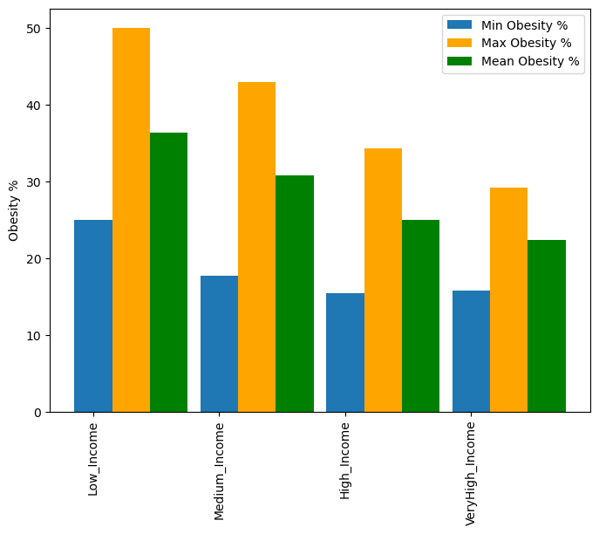
Analyses of Income and Obesity
-Mean Obesity Rates: The mean obesity rates decrease as income level increases.
This suggests a potential inverse relationship between income and obesity,
indicating that higher-income groups tend to have lower mean obesity rates.
-Range of Obesity Rates: The range (difference between maximum and minimum values)
within each income group shows the variability in obesity rates.
Lower ranges indicate less variability, while higher ranges suggest greater variability.
Income_Group | Mean_Obesity | Min_Obesity | Max_Obesity
Low_Income | 36.363687 | 24.95 | 50.042424
Medium_Income | 30.789992 | 17.754545 | 42.967797
High_Income | 25.011891 | 15.383333 | 34.263158
VeryHigh_Income | 22.314082 | 15.8 | 29.16

Slide 9
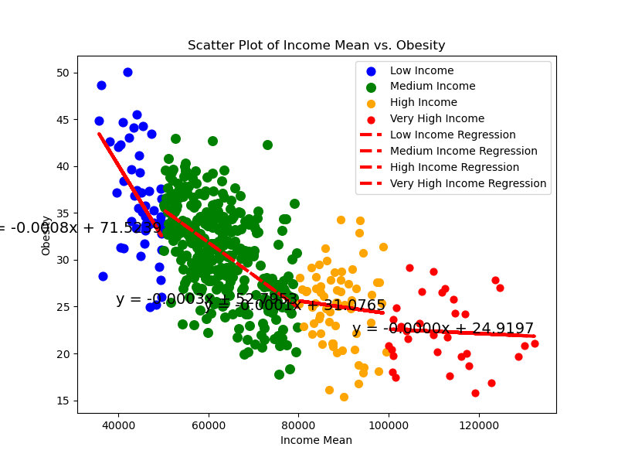
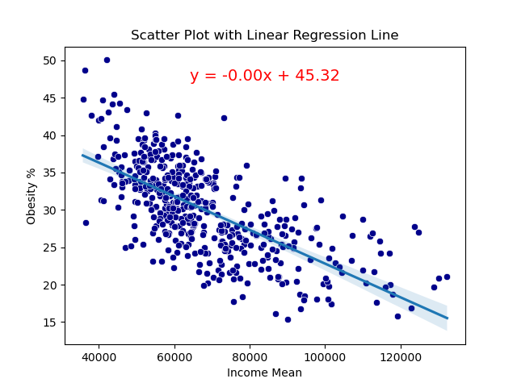
Correlation between Income and Obesity
From the plots and linear regression lines seems to be a correlation between Income and Obesity.

Slide 10
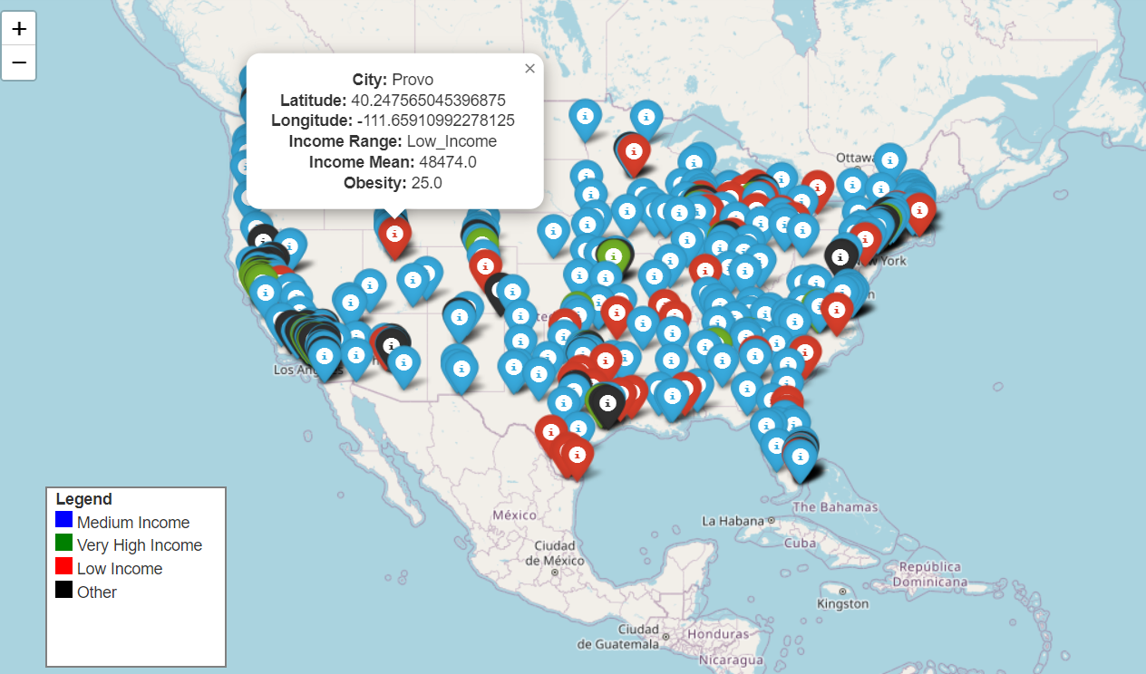
Map of Obesity categorized by Income
The map provides a view on which obesity is located by the city , and the income range. On the popup displays the Name of the City, Longitude, Latitude, Income Range, Income Average, Obesity Rate. Also the legends helps to define the range by the color.

Slide 11
Conclusion
The analysis highlights a consistent pattern: higher income levels are associated with lower obesity rates. Understanding this relationship is essential for developing targeted public health strategies and policies aimed at reducing obesity and promoting well-being. Further research, including a broader range of factors and regional considerations, would enhance our understanding of the complex dynamics between income and obesity.

Slide 12
Obesity vs Weather
Does weather have an effect on obesity rate?
- Raghen

Slide 13
Hypothesis to be Tested
Hypothesis
Null Hypothesis
Alternative Hypothesis
If weather is a causing factor (correlated) to US adult obesity, then we will see a higher percentage of adult obesity in cities that experience colder temperatures (harsh winter season as we have defined it).
A cities with colder avg low temperatures will not result in a higher percentage of obese adults.
US Cities with lower average temperatures and higher rates of precipitation will result in a higher percentage of obese adults.

Slide 14
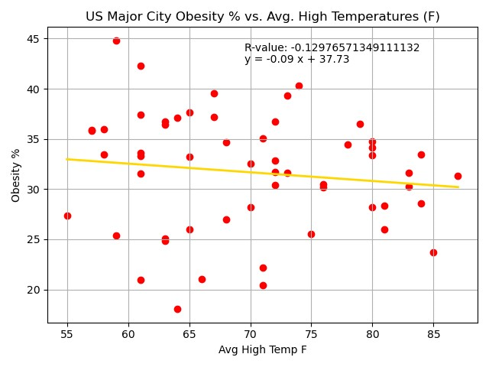
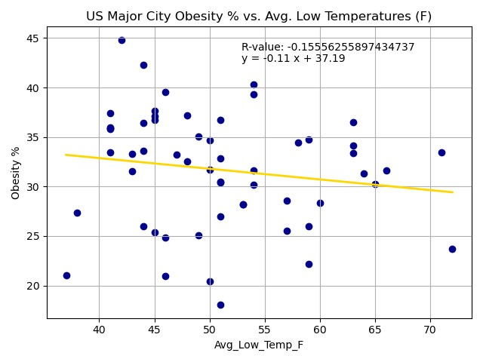
Analysis of Avg Low & High Temps
The weak inverse correlation tells us that as temperatures increase the obesity does not decrease.
When evaluating the major US cities, the avg high temperatures have no correlation to the percentage of obese people in the city.
The weak inverse correlation tells us that as temperatures decrease the obesity does not increase.
When evaluating the major US cities, the avg low temperatures have no correlation to the percentage of obese people in the city.
Notes:
However, considering both have a weak inverse correlation (Avg High Temperatures vs Obesity % R-value= -0.1298 & Avg Low Temperatures vs Obesity % R-value= -0.1556) , the R-values tell us that avg low temperatures have a slightly stronger inverse correlation to obesity percentage.

Slide 15
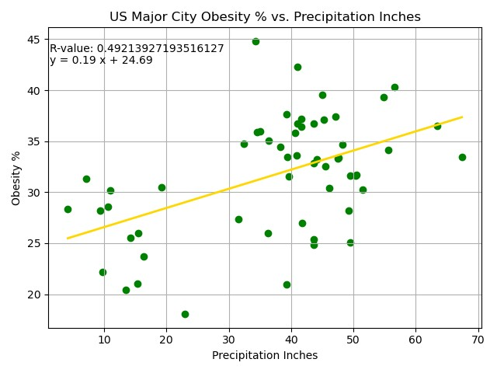
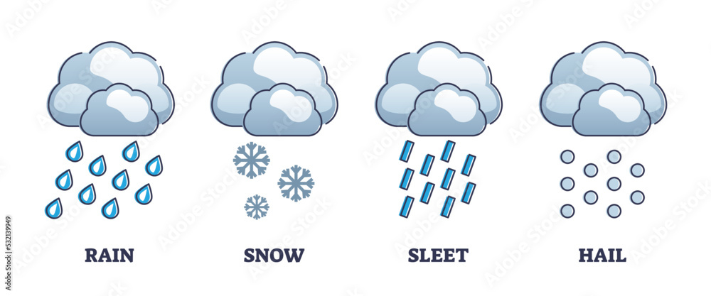
Analysis of Precipitation
The moderate positive correlation tells us that as precipitation increases the obesity increases.
When evaluating the major US cities, the avg precipitation has moderate correlation to the percentage of obese people in the city.

Slide 16
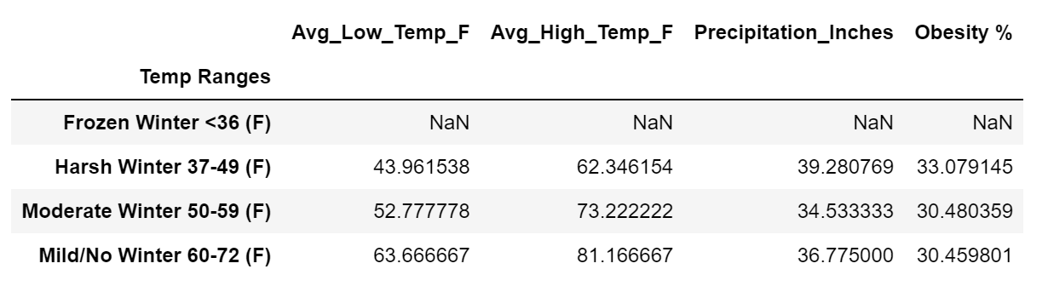
Cities & Winter Temperatures
Temp Decrease (Harsh Winter)
Obesity Increase

Slide 17
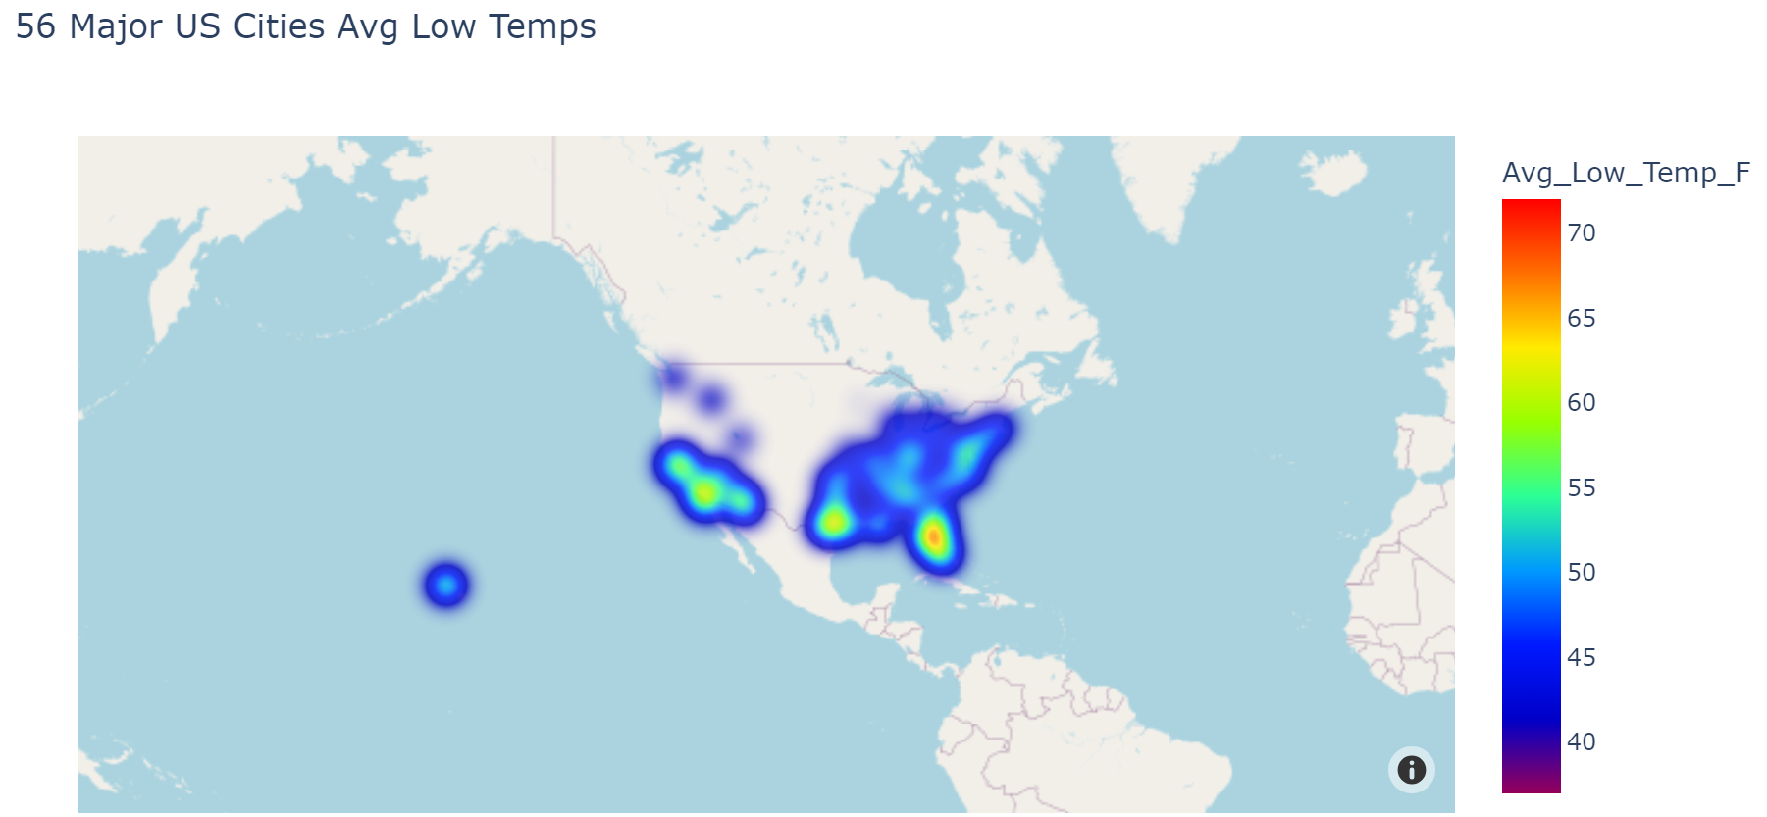
Average Low Temperatures Heatmap

Slide 18
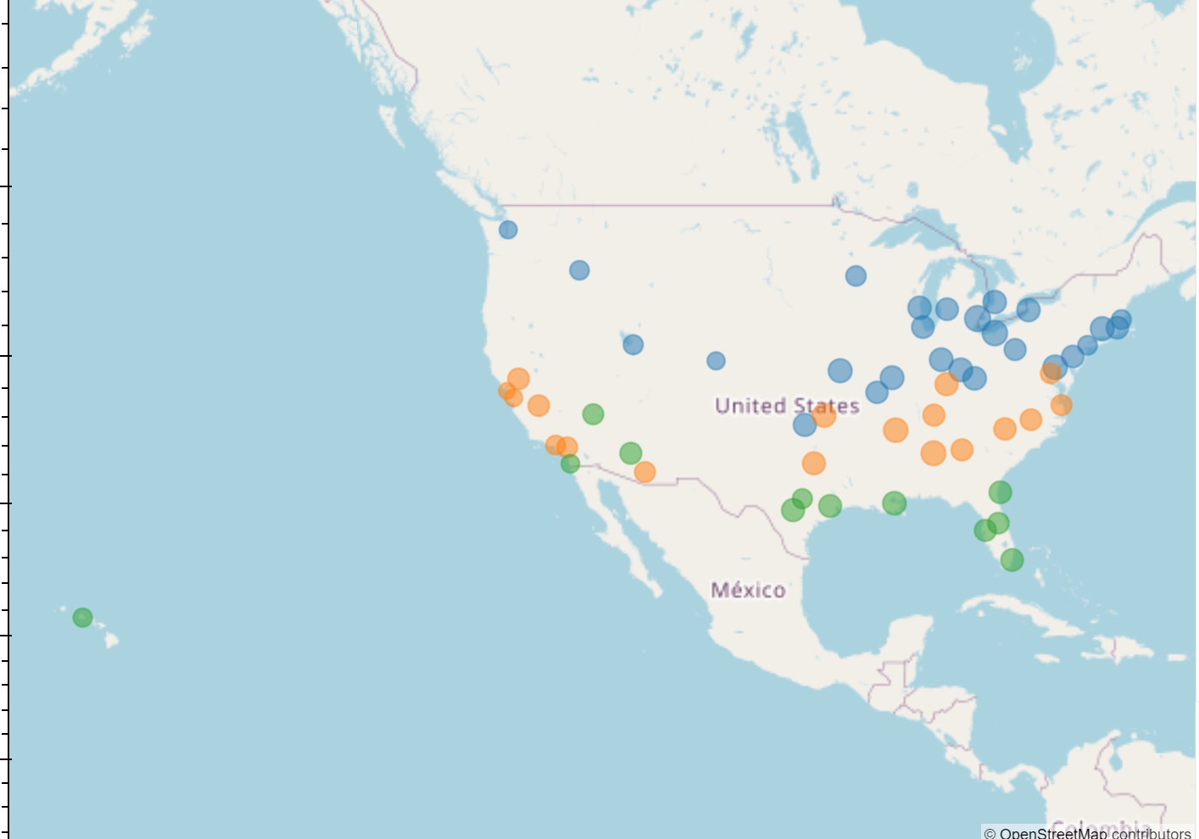
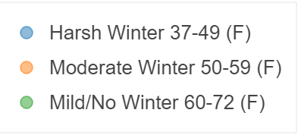
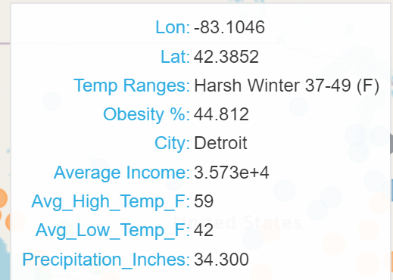
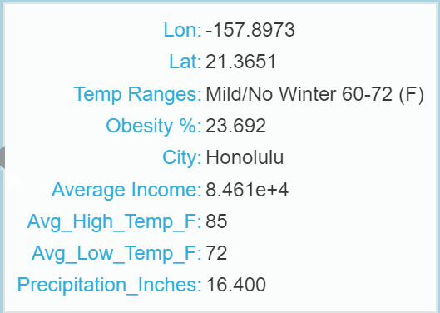
Cities & Winter Temperatures

Slide 19

Weather Conclusions
The results show there is some correlation between a cities weather (temperatures/precipitation) and adult obesity. The correlation is slight to moderate at best. Many other factors that were not considered in this analysis could have impact on the obesity percentages. For Example: we could have considered the amount of snow and/or the length of the winter season in the winter analysis.
Alternative Hypothesis
US Cities with lower average temperatures and higher rates of precipitation will result in a higher percentage of obese adults.

Slide 20
Obesity vs Walkability
How is city walkability correlated with obesity rate in over 18 adults?
Emilia

Slide 21
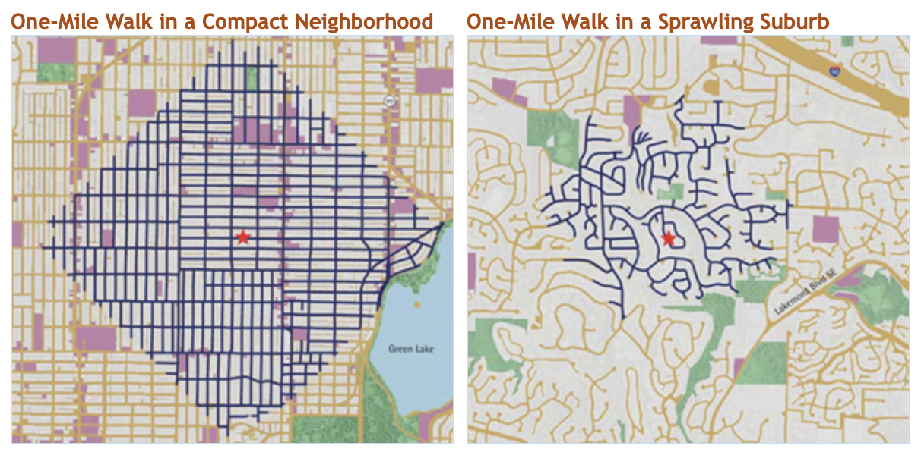
Walkability
refers to the ability to safely walk to services and amenities within a reasonable distance, usually defined as a walk of 30 minutes or less
A higher number (or score) means a location within a city has more accessible goods and services by foot
X

Slide 22
The main question we wanted to ask:
Is a city being more “walkable” correlated with a reduction in obesity rate?
If it is, by how much? Can we predict the difference?
Some considerations:
Want to control for income
Larger cities similar to the ones from the weather dataset

Slide 23
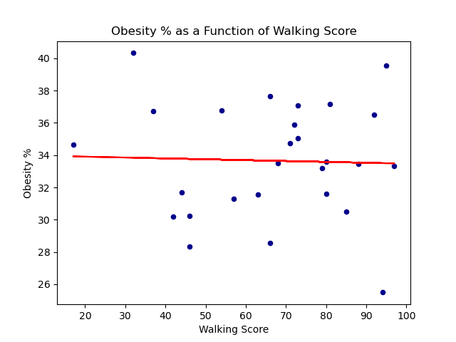
Visualizing Effect of Walk Score on Obesity %
Filter cities to average income between 50k USD/year and 65k USD/year
End up with ~25 cities
Plot/linregression of walk score vs obesity %

Slide 24
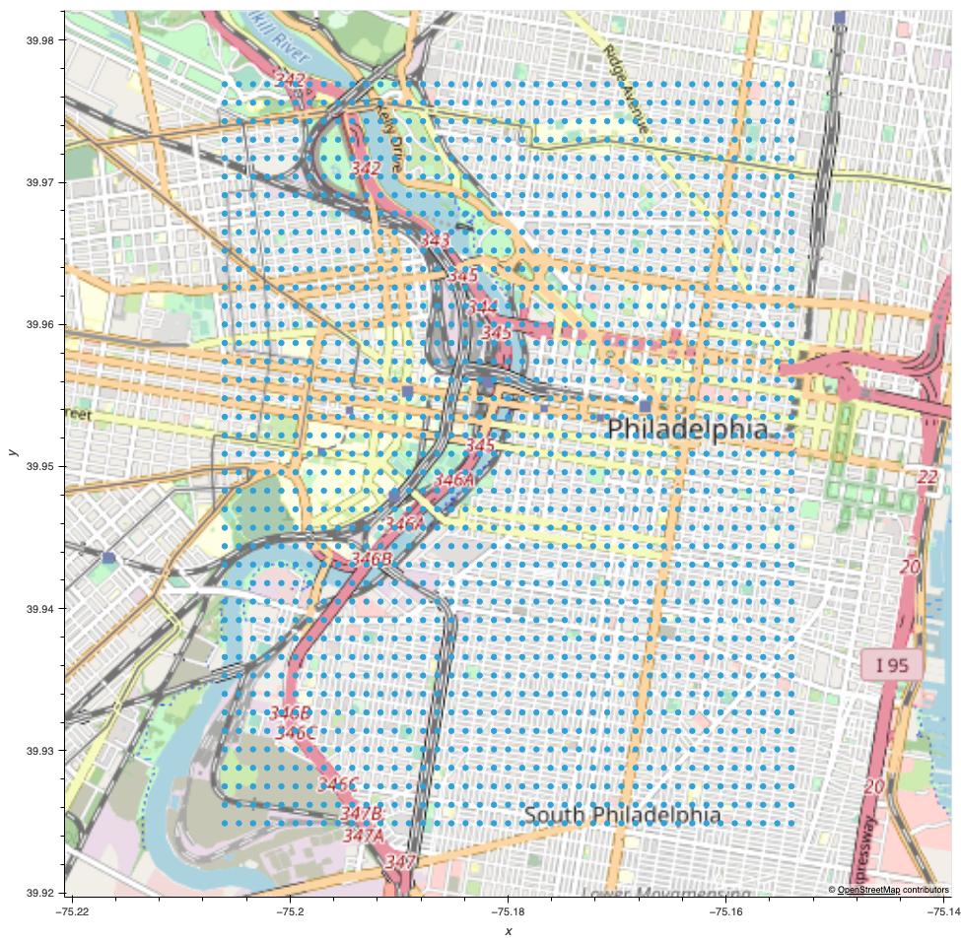
How is Walk Score Measured
It is measured for a specific address, snapped to by the latitude value
Taking one measurement is basically picking a point at random (bad idea)
Need to take enough samples of city to be accurate
Wrote small function to create grid of lat/lon, then find walkscore for each point, then take mean of all points

Slide 25
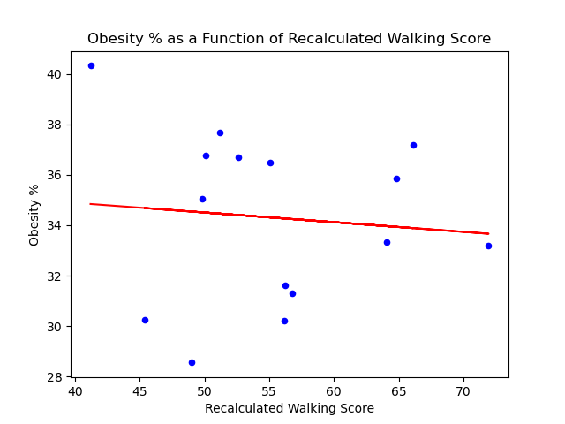
Replotting After New Walk Score Calculation
Smaller income filter
Still have ~20 cities
Plot/linregression of the recalculated walk score vs obesity %

Slide 26

Walkability Conclusions
City walkability has no correlation with that cities obesity rate
Too many confounding factors
Income is still the biggest correlation with obesity rate

Slide 27
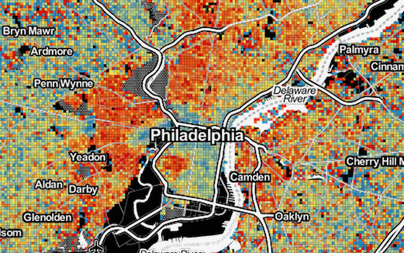
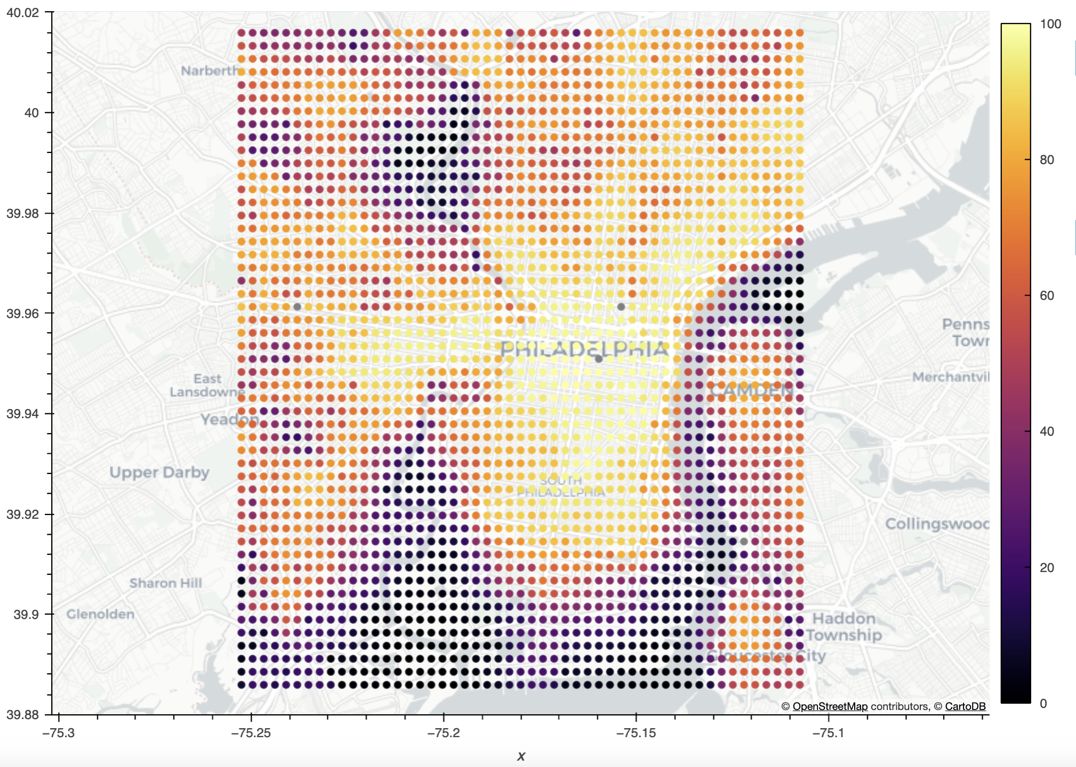
Bonus: Philadelphia Overlay

Slide 28
Bonus: Philadelphia Overlay

Slide 29
Resources

Slide 30
National Health & Nutrition Examination Survey Report 2017-2020
https://www.currentresults.com/Weather/US/average-annual-temperatures-large-cities.php
https://www.ncbi.nlm.nih.gov/pmc/articles/PMC5013721/
Maps cou
https://www.walkscore.com/walkable-neighborhoods.shtml

Slide 31
Project Task Breakdown
Task | Contributors
Project Ideas | All
Finding Data Sources | All
Data cleaning and DF creation | Emilia & Raghen
Walkability API and Analysis | Emilia
Weather Analysis | Raghen
Income Analysis | Elona
Deck creation & prep | Raghen
Project Outline | Emilia

